Slide 1



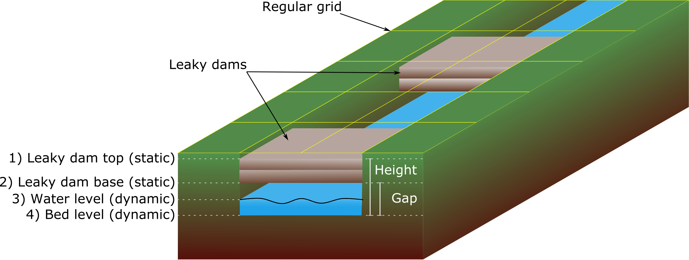
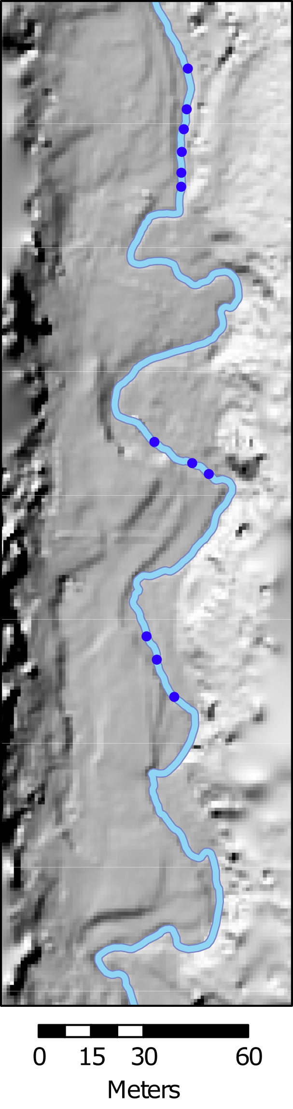
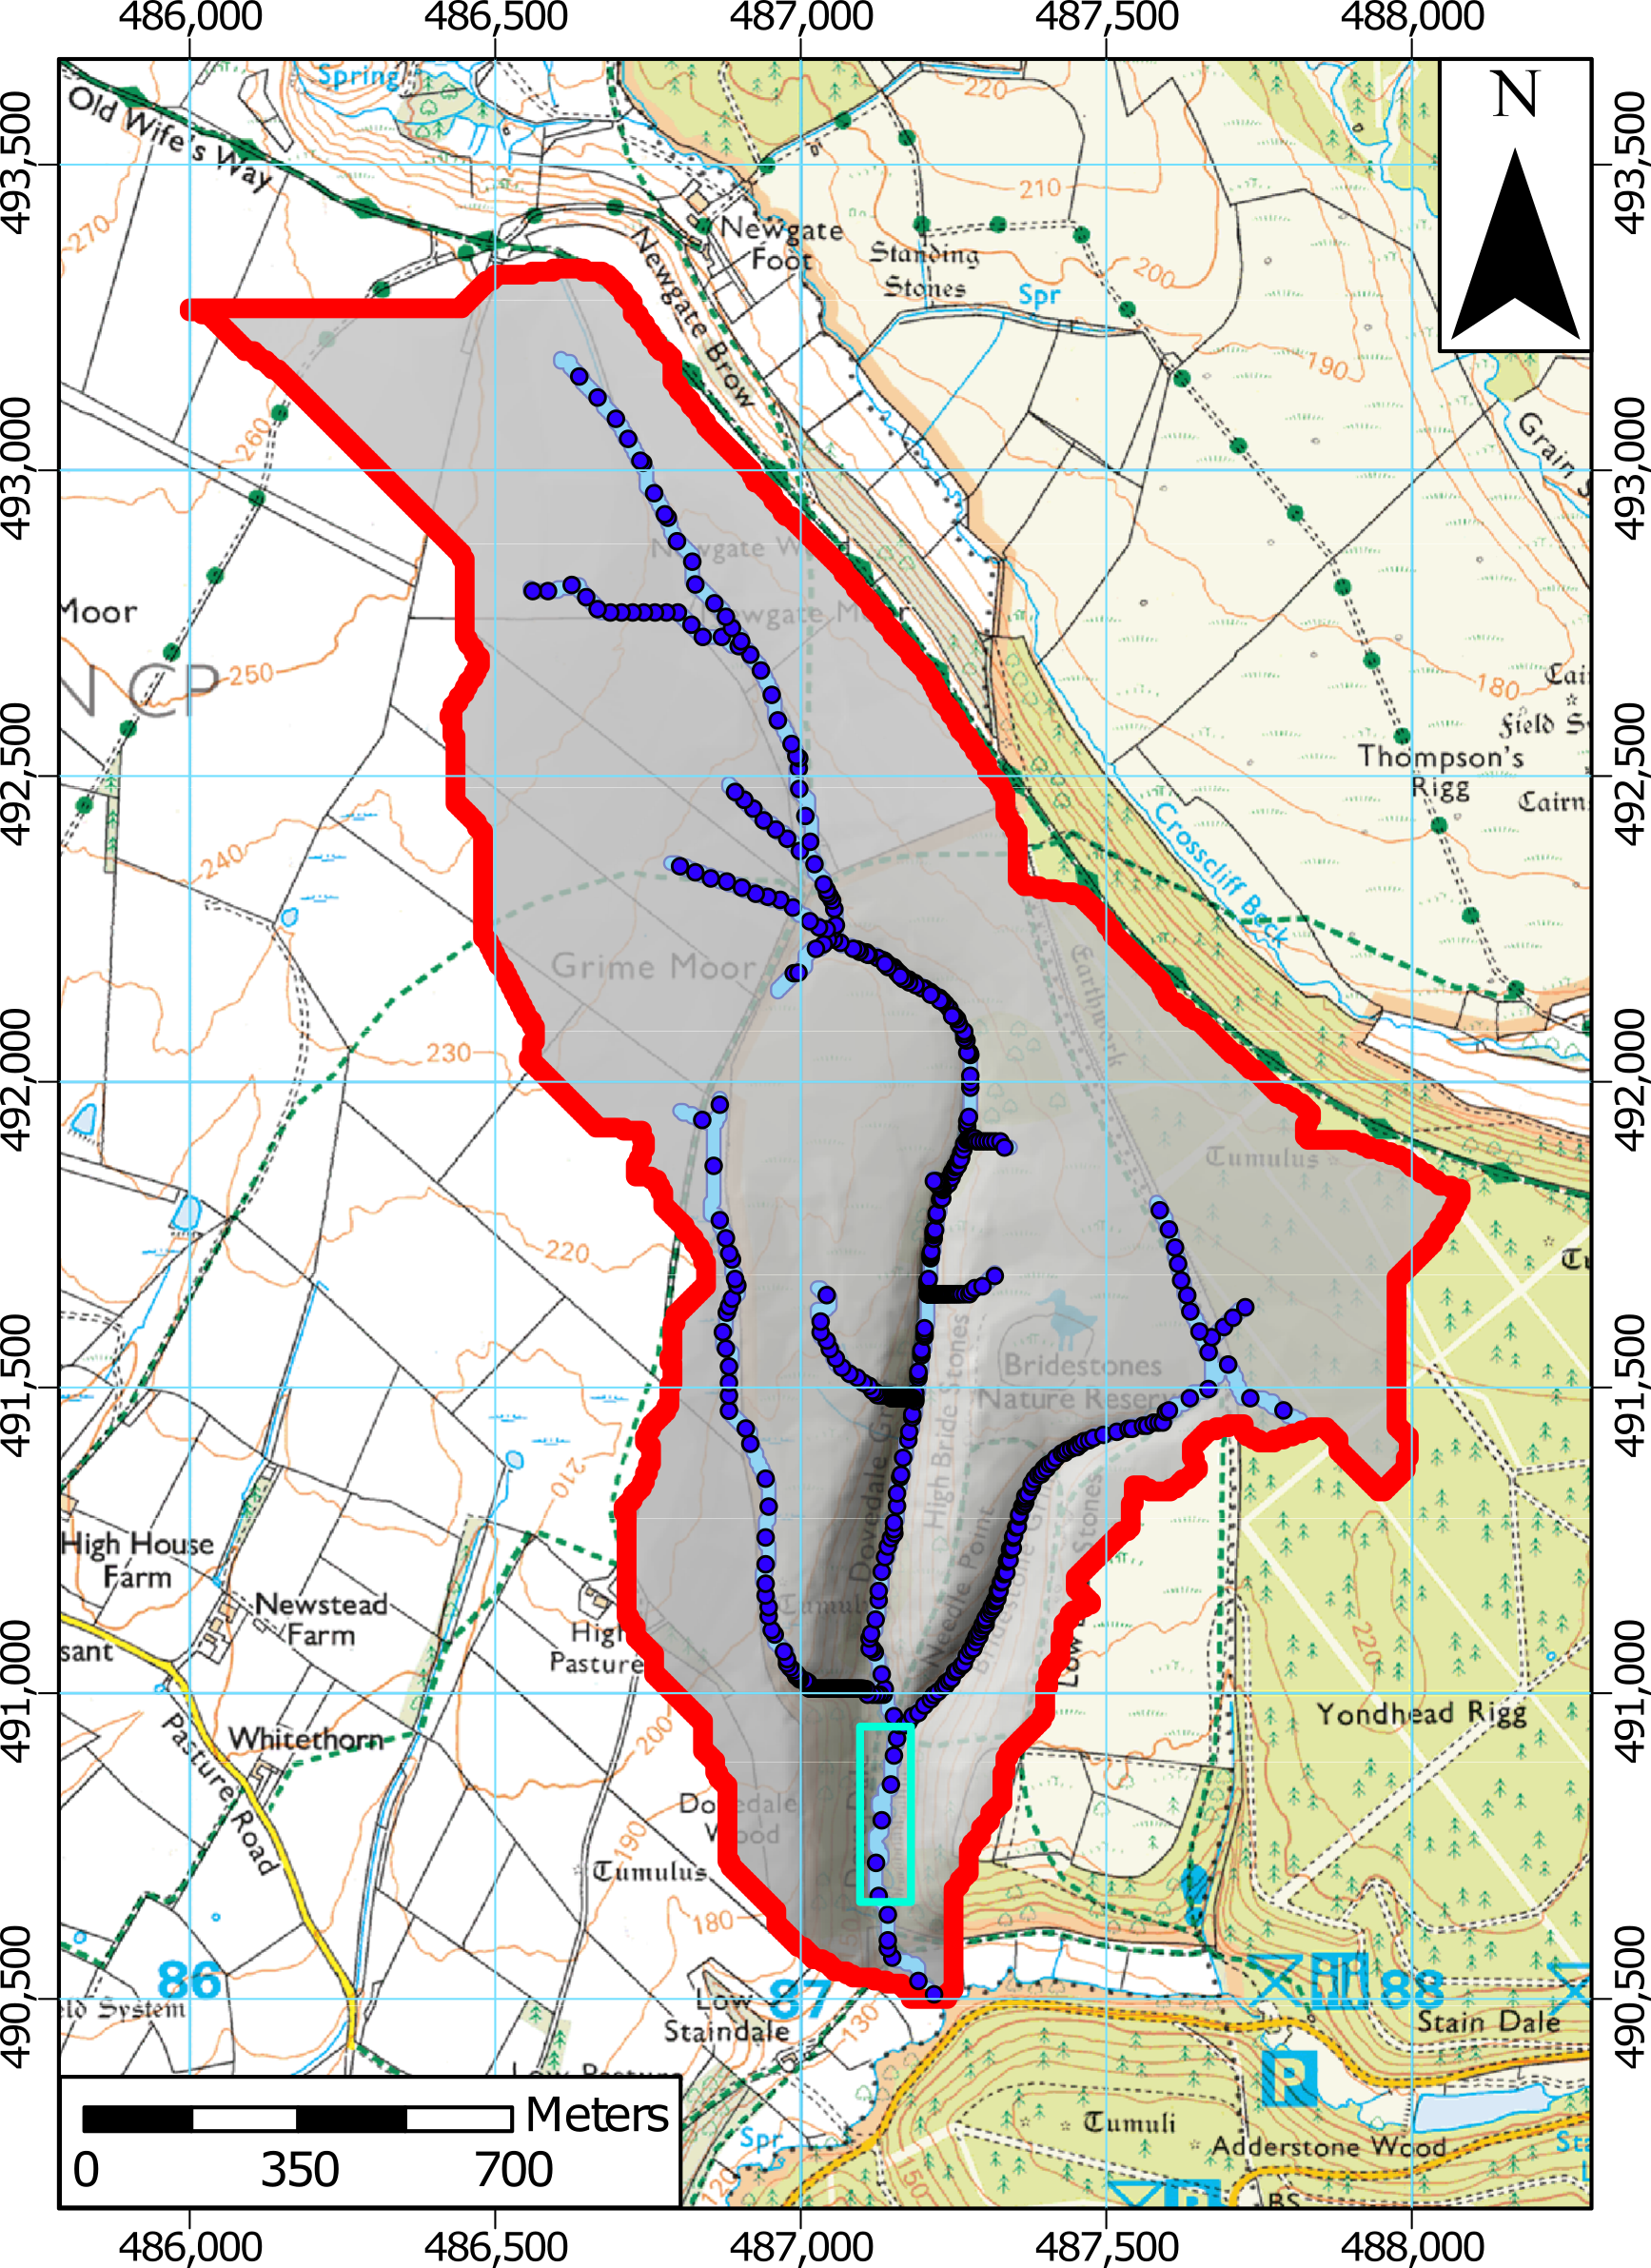

Geomorphological numerical modelling of woody dams in CAESAR-Lisflood
Josh Wolstenholme, Chris Skinner, David Milan and Dan Parsons
j.wolstenholme-2018@hull.ac.uk
@josh_NFM
Modelling dams at both reach and catchment scales
Woody dam representation in the model
Results (% change in peak flow from simulation without dams)
Flow Only
Sediment
1 in 10 year event, six hour storm
Modelling sediment transfer produces higher estimates for flood peak reduction

Slide 2
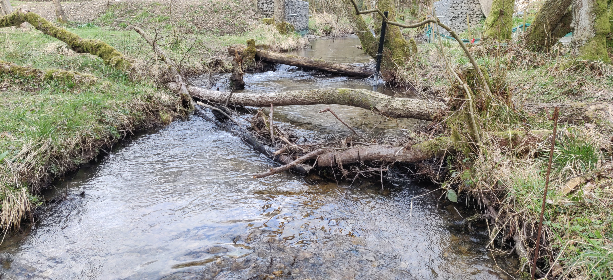
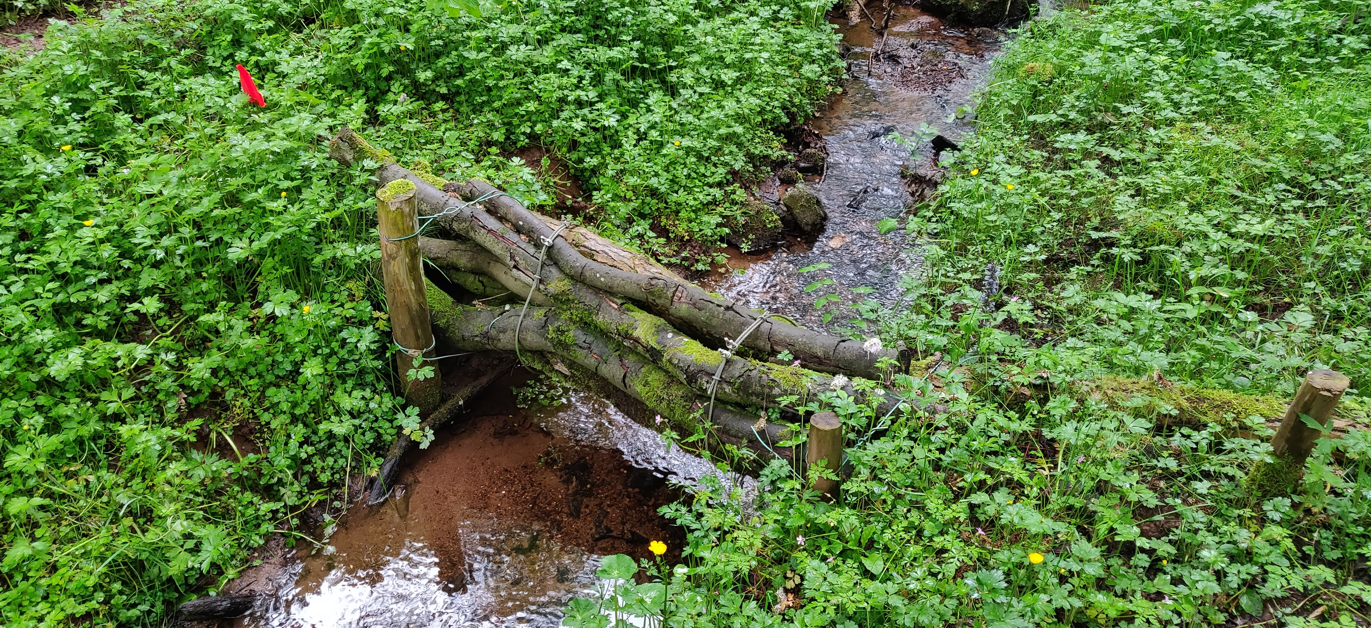
1a. What are (leaky) woody dams?
1. What are (leaky) woody dams?
2. What is CAESAR-Lisflood?
3. NFM Toolkit
4. Experiments
5. Preliminary Results
6. Importance and Implications
7. Future Work
Leaky dams are often semi-engineered structures designed to attenuate water during high flows, and to slowly release water over time.
Dam designs across the UK are highly variable, and their impact and efficacy at the catchment scale on flood peak reduction and sediment transfer is still largely unkown.

Slide 3
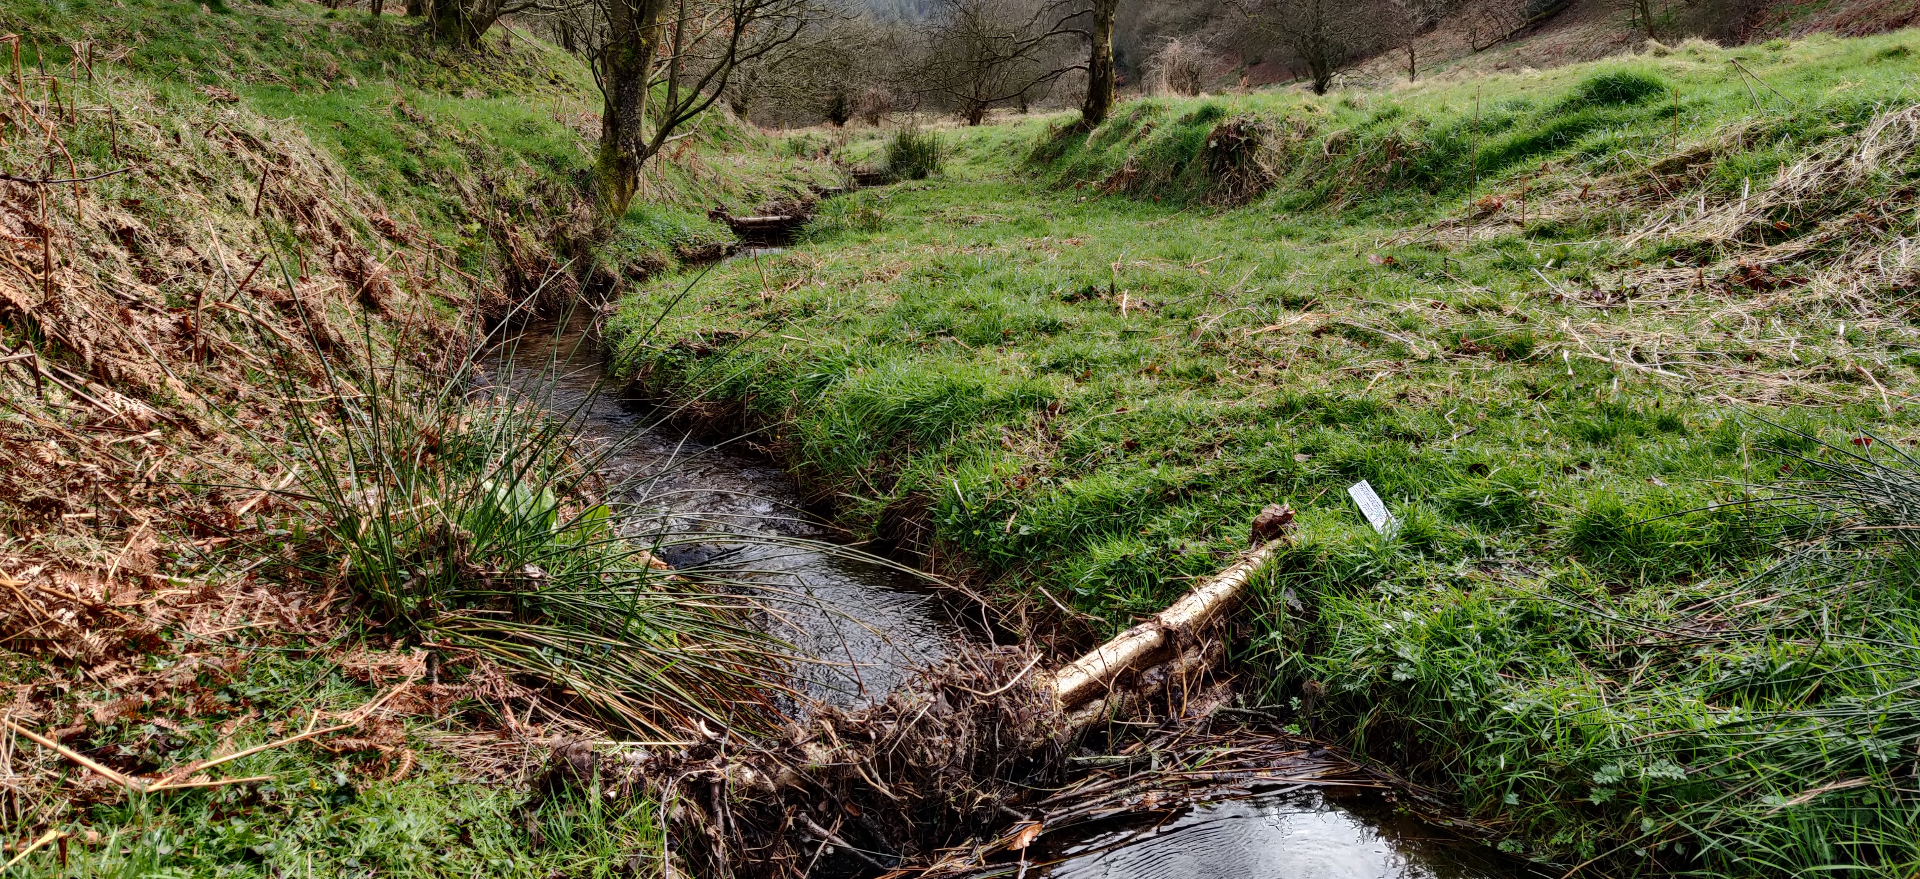
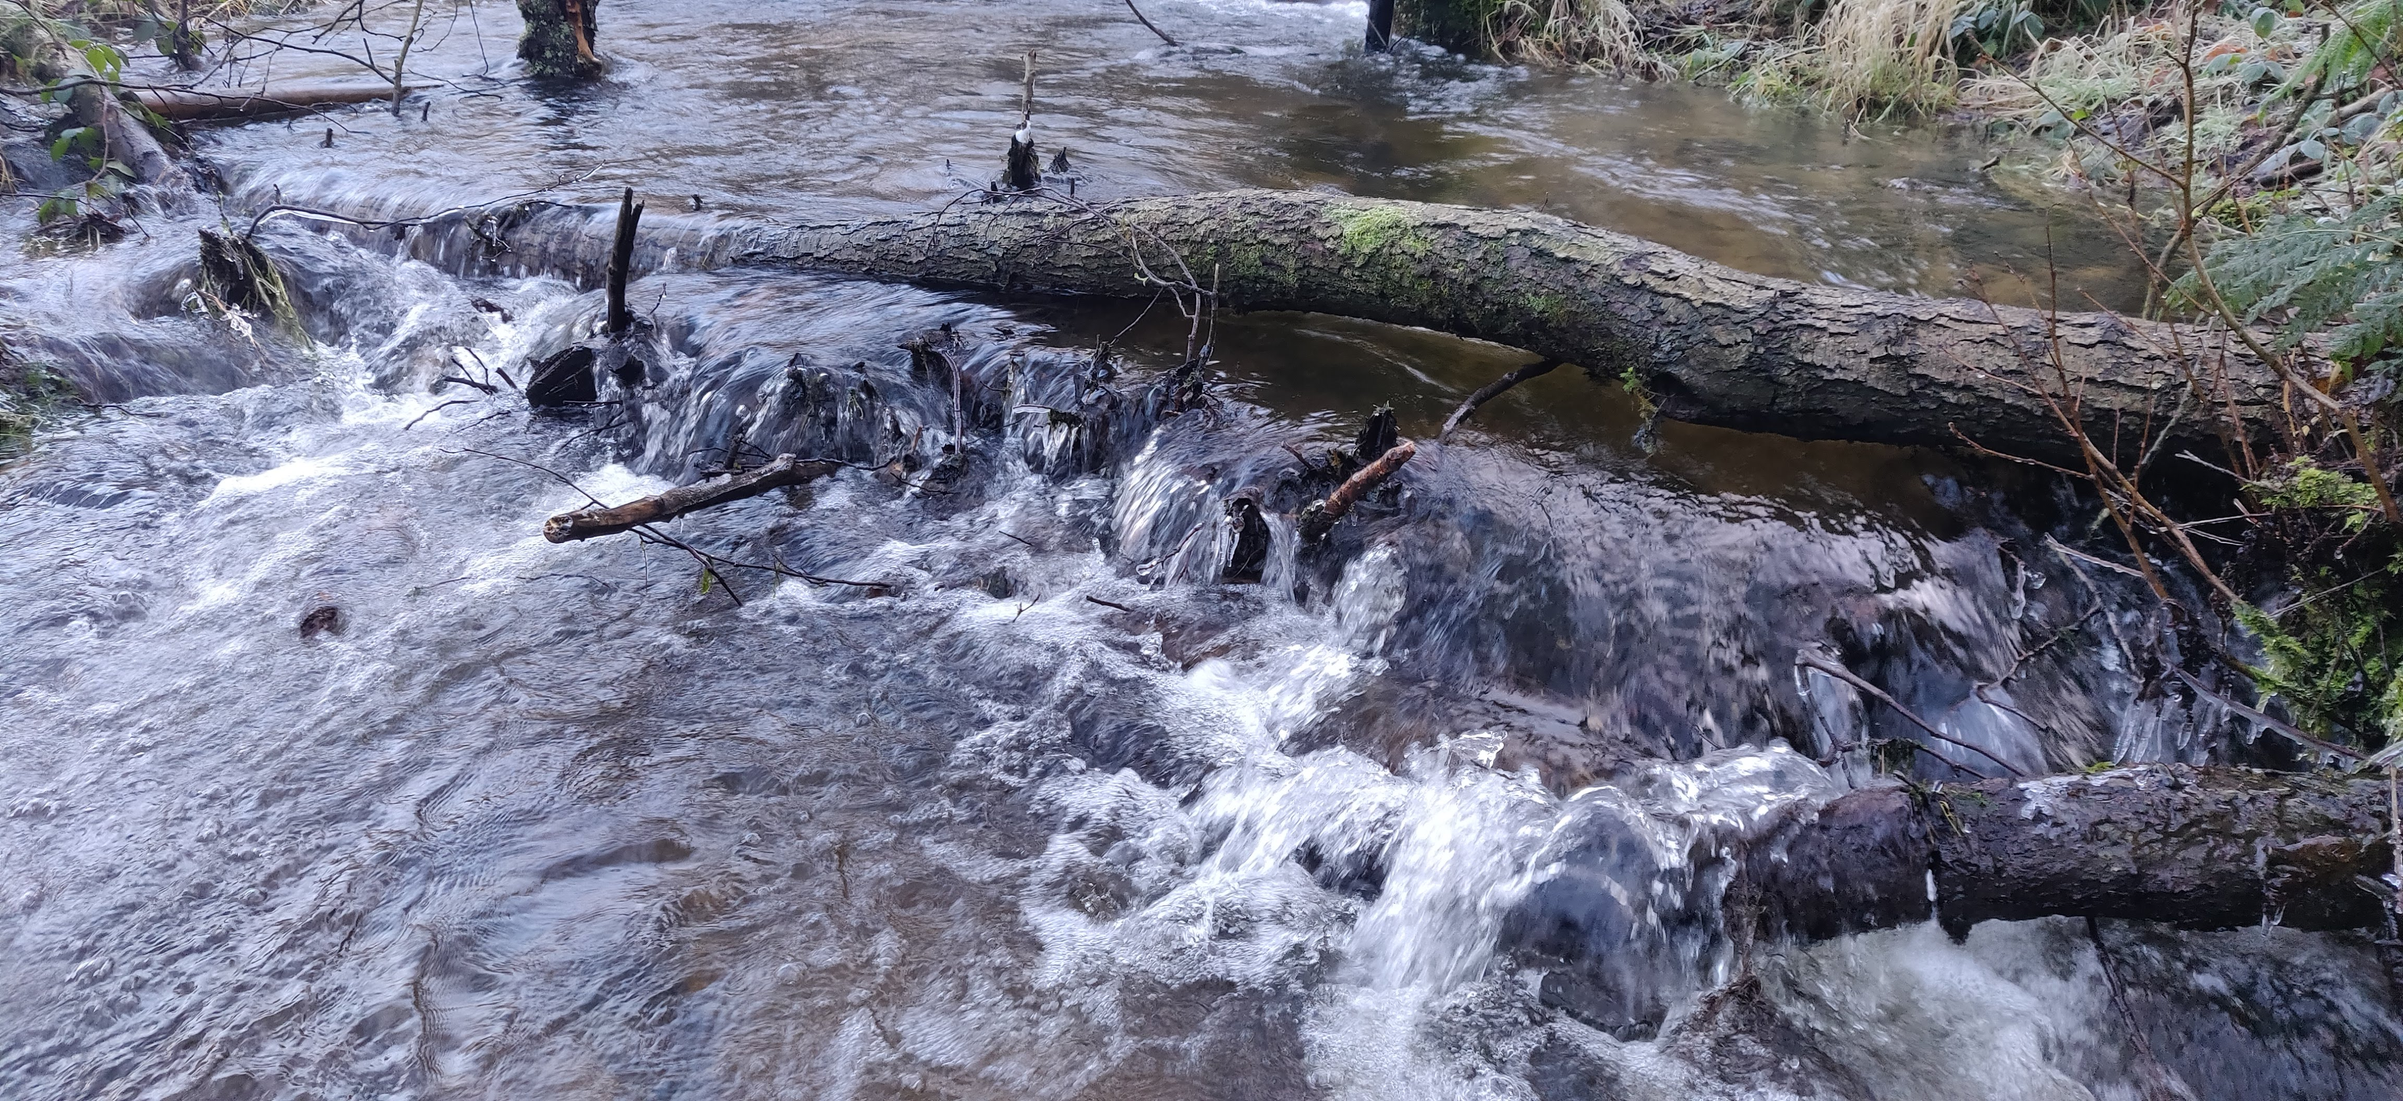
1b. Project purpose
1. What are (leaky) woody dams?
2. What is CAESAR-Lisflood?
3. NFM Toolkit
4. Experiments
5. Preliminary Results
6. Importance and Implications
7. Future Work
Most numerical modelling does not consider how the efficacy of the dams evolve as they retain sediment, and the potential implications for flood risk management downstream. Rivers are not static, and sediment transfer must be accounted for.
Here we develop a tool capable of modelling dams at both the reach and catchment scales to assess best placement of dams and future risks/rewards.
Using CAESAR-Lisflood (Coulthard et al., 2013), an NFM toolkit has been created, capable of modelling leaky woody dams at the reach scale.

Slide 4
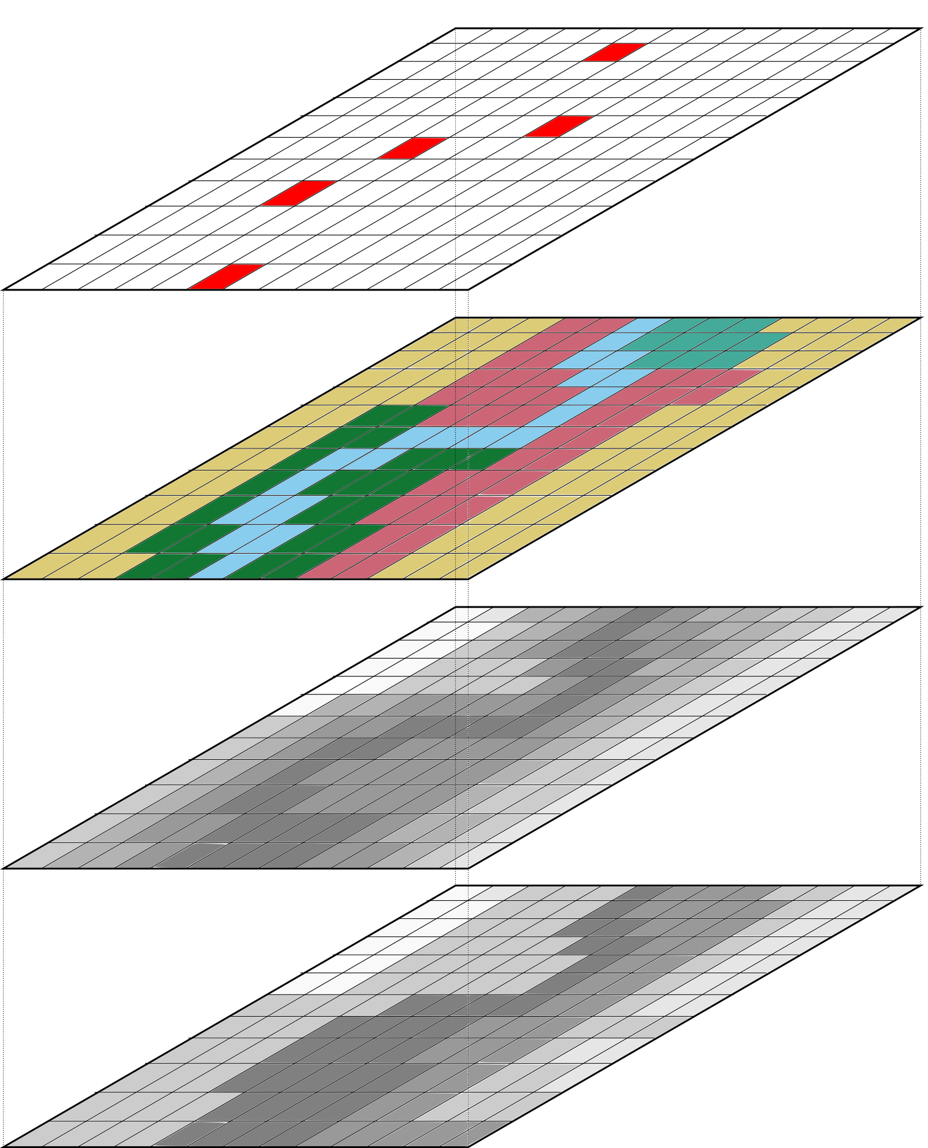
2. What is CAESAR-Lisflood?
1. What are (leaky) woody dams?
2. What is CAESAR-Lisflood?
3. NFM Toolkit
4. Experiments
5. Preliminary Results
6. Importance and Implications
7. Future Work
NFM
Intervention
Land Use
(as roughness)
Topography
Bedrock
CAESAR-Lisflood (C-L) is the integration of the landscape evolution model CAESAR and the hydrodynamic model Lisflood-FP (Coulthard et al., 2013). C-L is able to run simulations over high and coarse spatial and temporal resolutions (<5 - 50 m grid size, minute to millennia timesteps).
Here, the NFM toolkit adds an input layer to define dam locations within the catchment or reach.

Slide 5
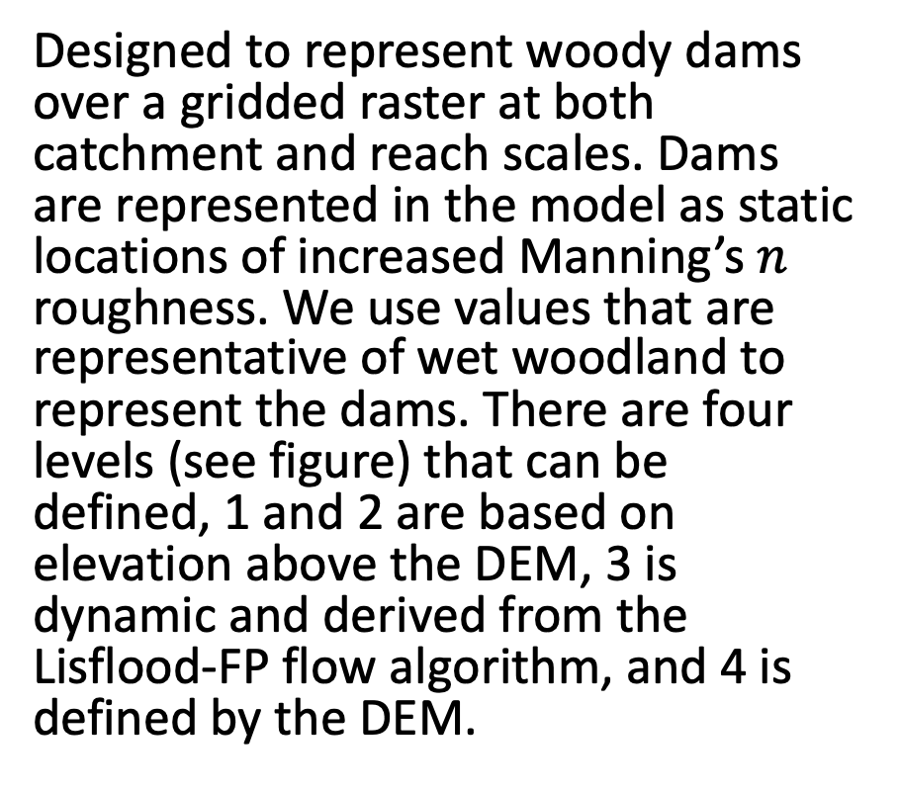
3a. NFM Toolkit
1. What are (leaky) woody dams?
2. What is CAESAR-Lisflood?
3. NFM Toolkit
4. Experiments
5. Preliminary Results
6. Importance and Implications
7. Future Work
Designed to represent woody dams over a gridded raster at both catchment and reach scales. Dams are represented in the model as static locations of increased Manning’s $n$ roughness. We use values that are representative of wet woodland to represent the dams. There are four levels (see figure) that can be defined, 1 and 2 are based on elevation above the DEM, 3 is dynamic and derived from the Lisflood-FP flow algorithm, and 4 is defined by the DEM.

Slide 6
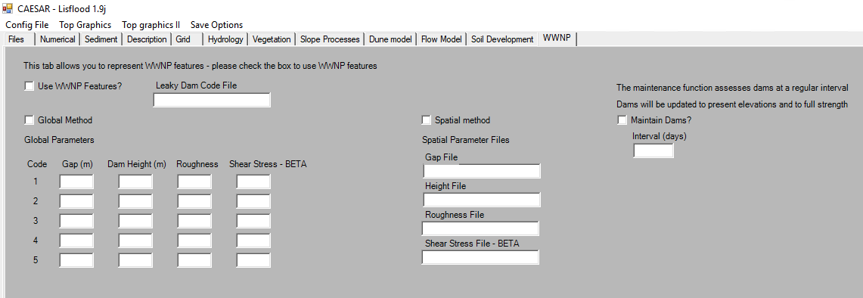
3b. NFM Toolkit
1. What are (leaky) woody dams?
2. What is CAESAR-Lisflood?
3. NFM Toolkit
4. Experiments
5. Preliminary Results
6. Importance and Implications
7. Future Work
Activates spatial method for representing dams. Each dam can be represented as an individual pixel with individual properties (UNTESTED)
Activates WWNP package and links to dam location raster
Every n days based on the interval the dams will regenerate to represent ongoing maintenance (UNTESTED)
Activates global method for representing dams. Up to five dam types can be defined with individual gaps, heights, roughness and shear stress coefficients.

Slide 7
4a. Experiments
1. What are (leaky) woody dams?
2. What is CAESAR-Lisflood?
3. NFM Toolkit
4. Experiments
5. Preliminary Results
6. Importance and Implications
7. Future Work
Reach and catchment elevation models, dots represent woody dam locations
Woody dams at both the reach and catchment scales are modelled to identify the impact of modelling with and without sediment on flood peak reduction and sediment flux.
The dam gap and roughness were altered to also assess their impact on flood peak reduction and sediment flux.

Slide 8
4b. Experiments
1. What are (leaky) woody dams?
2. What is CAESAR-Lisflood?
3. NFM Toolkit
4. Experiments
5. Preliminary Results
6. Importance and Implications
7. Future Work
Six different storms were modelled based on the Flood Estimation Handbook calculated return periods, these are one, 10 and 100 year events, with six and 72 hour durations. Storms were repeated 10 times back-to-back to extract the average impact of the dams on the flood peak.

Slide 9
5. Preliminary Results – Reach six hour storm
1. What are (leaky) woody dams?
2. What is CAESAR-Lisflood?
3. NFM Toolkit
4. Experiments
5. Preliminary Results
6. Importance and Implications
7. Future Work
Across flow only and sediment, and for all return periods, it is beneficial to be more restrictive (in regards to both parameters). For flow only, 1 in 100, peak reduction is best at either the most or the least restrictive in terms of gap height and chosen roughness
Flow Only
Sediment
1 in 1 year
1 in 10 year
1 in 100 year

Slide 10
5. Preliminary Results – Reach 72 hour storm
1. What are (leaky) woody dams?
2. What is CAESAR-Lisflood?
3. NFM Toolkit
4. Experiments
5. Preliminary Results
6. Importance and Implications
7. Future Work
Flow Only
Sediment
For flow only it is best to have restrictive dams with large gaps. For sediment, it is mostly beneficial to just be less restrictive in all senses.
1 in 1 year
1 in 10 year
1 in 100 year

Slide 11
6. Importance and Implications
1. What are (leaky) woody dams?
2. What is CAESAR-Lisflood?
3. NFM Toolkit
4. Experiments
5. Preliminary Results
6. Importance and Implications
7. Future Work
Most work modelling dams in the literature is hydrologically or hydraulically focused, despite rivers actively transferring sediment throughout the catchment. Dams used for flood risk management actively capture sediment and therefore are likely to reduce in flood risk management efficacy following storm events, especially when not cleared out/maintained, especially if sediment accumulations are not removed. Here we present a tool that has the potential to estimate maintenance schedules, sediment storage and impact to future flood events. The changes seen in this stage of work however are very small, with a maximum of 1.4% reduction in flood peak. Clearly future work is required to optimise design and location of these interventions.

Slide 12
7. Future Work
1. What are (leaky) woody dams?
2. What is CAESAR-Lisflood?
3. NFM Toolkit
4. Experiments
5. Preliminary Results
6. Importance and Implications
7. Future Work
Full catchment modelling experiments
Full sensitivity analysis of the NFM toolkit using the Morris Method (1991)
Assess the impact of dam location on flood peak reduction
Link the model to empirical field data

