Slide 1
A “co-produced curriculum”: embedding mental health lived experience into mental health nurse education
Caroline Davenport and Carolyn Maile June 2024

Slide 2
Introduction…
Hi and welcome-we’d like to introduce ourselves!
Caroline Davenport-Admissions lead - BSc Mental Health Nursing, University of Hull
Carolyn Maile-Programme Director - BSc Mental Health Nursing, University of Hull
Started working together in June 2023
Numerous observations and discussions brought us to this curriculum discussion which we’d like to share with you today-these are OUR experiences

Slide 3
What is co-production?
Nothing about us, without us…but what about higher education?

Slide 4
Co production is..
Co-production is about developing more equal partnerships between people who use services, carers and professionals when designing and delivering activities, projects or services
Equality - Co-production starts from the idea that no one group or person is more important than anyone else and everyone has skills, abilities and time to contribute.
Reciprocity - Reciprocity means people get something back for putting something in. There are formal ways of doing this, like using time banks as a way of rewarding people, but sometimes the reciprocity comes from the more equal relationships that develop between people and organisations.
Diversity - Co-production should be as inclusive and diverse as possible. Particular efforts may be needed to make sure seldom heard groups are included.
Accessibility - Making everything accessible is the way to make sure everyone has an equal opportunity to participate fully in an activity in the way that suits them best.
Quotes reproduced from https://www.mind.org.uk/media-a/4640/the-co-production-festival-info-sheet-v2_comms-edit_clean.pdf

Slide 5
Co-production in higher education
Co-production has been extended to health professionals’ education (Atwal et al., 2018)
Higher education can be a valuable environment for meaningful involvement with service users/carers (McIntosh, 2018)
Family carer involvement results in:
Carers having an impact on their selves, e.g. having a purpose
Making a difference
Challenging perceptions
Humanising illness (McIntosh, 2018)

Slide 6
Why the focus?
There is only so much nurse lecturers can teach about mental health- the academic and theoretical underpinnings of mental health are conceptual, they can lack application to understanding of the lived experience-appearing abstract to the developing learner
Mental Health Nursing as a profession is evolving with recent roots grounded in service user participation and co production
More teaching should be “co-produced” and be influenced and delivered by working alongside people with lived experience.
We have a diverse and rich cohort- the design and delivery of the curriculum. Inclusivity requires a collective approach- participative pedagogy
Create an inclusive learning environment that aims to reflect and validate the service user experience, learner and staff experience

Slide 7
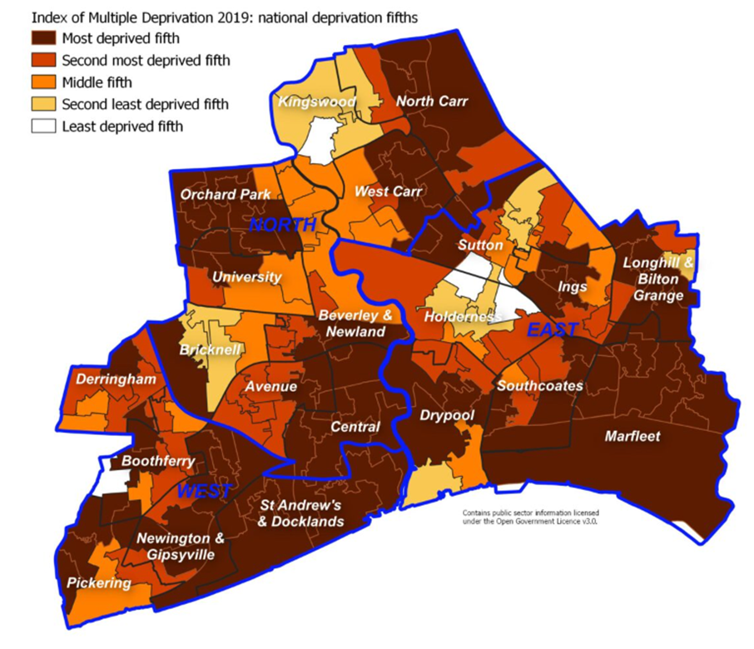
The focus on Hull
Hull is the fourth most deprived city in the UK (Hull City Council, 2024)
High percentage of students are ‘home students’ (approx 75% per cohort)
University Certificate in Health and Social Care as an entry route
Cohorts of students with personal experiences of adverse experiences defined by mental ill health-
Informing us that these influence their motivation for a career in mental health nursing

Slide 8
Co production has the power to “solve complex issues, recognising the value of all stakeholders” (Brook et al., 2020)
When done poorly it can be harming:
Tokenistic (not true inclusion)
Reinforce power imbalance (academic staff vs service user as different)
Not value lived experience (e.g. not offering payment) (O’Brien and Davenport, 2024)
This has been referred to as “faux-production” (Grundy-Twitter, July 2024)

Slide 9
What are we doing at Hull?
Institution, faculty, team

Slide 10
Establishing an inclusive and supportive culture for Su/C co production through shared principles and values
Embed Su/C co production in our process and practice
Promote Su/c presence internally/externally by increasing physical and online presence
Have clear processes for Su/C co production
Monitor impact of Su/C to professional learning and development of students, the design & delivery of programmes and the health and wellbeing of Su/C
Institution Service user and carer co production strategy for teaching and learning (Zaheerali et al.,2020)

Slide 11
Faculty of Health Sciences at Hull:
We have a range of SUCs with expertise including:
Physical health and disability
Mental health and addiction
Caring experience
Involved at all levels from admissions to graduation
Paid at grade 2 for interviews
Paid at grade 7 for teaching
Hourly rate

Slide 12
Nursing and Midwifery:
Whole group lectures, e.g. about mental illness or self harm-teaching based on own experiences
Student workshops, e.g. to share experiences of caring or illness-allows for more interactive discussion and questions
Ensure all teaching staff have access to Su/C CV from the main portfolio
Help for staff to identify how Su/C can be involved
We shout about how proud we are to work alongside Su/C
Continually reflect on opportunities to develop involvement
“Human libraries”, where students can hear lived experience from many SUCs in groups
Role play scenarios for observed assessments
Panels for interviewing and revalidation of programmes

Slide 13
The Mental Health Nurse BSc programme
Current:
All field specific modules have Su/C teaching and experience- this is included in module specification.
We co produce innovative teaching content with inclusion from Su/C, students and practice partners.
Key stakeholder in interviewing- taking part & reviewing the structure and content
Future:
Su/C Reviewing the curriculum at the end of each academic year- language, evidence and application/relevance
Su/C Take part in reviewing the admissions process- co create a values based shortlisting tool.
Su/C Support to design sensitive and relevant mental health specific simulation scenarios
Support the organisation to grow our Su/C portfolio- with a focus of increase in representation from diverse populations (Eg: Refugee and Migrant, Gypsy and Traveller)
Understand better the needs of our student population and influence support for study
BIG WISH: help develop research skills to help with our research plans!

Slide 14
An example of transforming an idea into reality-The challenge ‘We are keen to review the experience of students of MHN who have lived experience. We spend a lot of time in the who, where, why , what landscape and no matter how we try, we cannot fix the limited resource issue that stops us from being able to undertake a meaningful co produced study that could help inform better what the lived experience will bring to the future workforce’ Imagine if we could go further and support our Su/C to be part of our research teams? Resource issue resolved! Valuable knowledge gained! Meaningful educational opportunities! Skills advancement!

Slide 15
Individual-Caroline and Sam
Based on the limitations of co-production i.e. that including service user voice can be challenging
Aimed to achieve “true” co-production, working together to plan learning outcomes, content, delivery and evaluation
Successful example of codesign and codelivery aligning to local policy (Humber Teaching NHS Trust, nd)
Took a long time, required mutual respect and patience
Highly rewarding!
(O’ Brien and Davenport, 2024; Davenport and O’Brien, 2024)
From interview through to graduation, an example of which we recently published (O’Brien & Davenport, 2024)

Slide 16
Short term process:
Priority planning-what needs changing and when?
Acknowledging the changing demographic of students being open about motivations to MH nursing
Reviewing admissions process
Reviewing support process-support for study
Start at an organizational level
Determine need and situation
Review data

Slide 17
Medium term
Collate feedback from students about service user contributions
Identifying success and areas for improvement
Take this back to SUCs-how can we work better together?
Facilitate Co-design
Planning for future Co-delivery
(Humber NHS Foundation Trust, nd)

Slide 18
References:
Atwal A et al (2018) Service user and academics teaching together in nurse education. Nursing Times, 114(6), 47-51.
Brook, J., Aitken, L., MacLaren, JA, Salmon, D. (2020). Co-production of an intervention to increase retention of early career nurses: Acceptability and feasibility. 27: 102861.
Horgan et al. (2018). “To be treated as a human”: Using co-production to explore experts by experience involvement in mental health nursing education-the COMMUNE project. International Journal of Mental Health Nursing. 27, 1282-1291.
Hull City Council. (2024). Hull Joint Strategic Needs Assessment. https://www.hulljsna.com/
McIntosh, GL. (2018). Exploration of the perceived impact of carer involvement in mental health nurse education: Values, attitudes and making a difference. Nurse Education in Practice. 29, 172-78.
National Collaborating Center for Mental Health. (2019). Working well together. https://www.rcpsych.ac.uk/docs/default-source/improving-care/nccmh/working-well-together/working-well-together---evidence-and-tools-to-enable-co-production-in-mental-health-commissioning.pdf
National Health Service England. (nd). Co-production. https://www.england.nhs.uk/always-events/co-production/
Humber Teaching NHS Trust (nd). An Introduction to Coproduction. https://www.humber.nhs.uk/downloads/Recovery%20College/Coproduction%20Toolkit.pdf
O’ Brien, S., Davenport, C. (2024). Embedding the service user voice to co-produce UK mental health nurse education-a lived experience narrative. Journal of Psychiatric and Mental Health Nursing. 00, 1–7. https://doi.org/10.1111/jpm.13031
Davenport, C., O’Brien, S. (2024). A co-produced teaching experience to promote nursing students’ care and compassion towards mental health service users. https://www.hull.ac.uk/choose-hull/study-at-hull/teaching-academy/news/a-co-produced-teaching-experience-to-promote-nursing-students-care-and-compassion-towards-mental-health-service-users

Slide 19
c.j.davenport@hull.ac.uk
c.maile@hull.ac.uk

